Slide 1
ALS Amyotrophic Lateral Sclerosis
Neuro 3

Slide 2
Terminology FYI
Aka ’Lou Gehrig’s’ disease
You may also hear it referred to as ‘motor neuron disease’ MND
(most commonly in UK and Australia)
However, ALS is actually just one type of MND, albeit the most common
In Europe ALS is sometimes called ‘Charcot’s disease’
(after famous french neurologist – ‘father of neurology’ described it as ‘creeping paralysis’ first identified over 160 years ago)

Slide 3
ALS in summary
Idiopathic and devastatingly fatal
>60% of individuals die within 3 years of onset, usually of respiratory failure (Mitchell & Borasio 2007)
Characterized by degeneration and loss of motor neurons in spinal cord + brainstem CN nuclei (lower motor neurons LMN) and motor cortex (upper motor neurons UMN)
Results in variety of LMN and UMN signs and symptoms
Cognitive, sensory and ANS generally well preserved
Will clinically see a rapid change/decline in level of function

Slide 4
Learning Objectives
1. Describe the epidemiology, etiology, pathophysiology, diagnosis, general clinical course, prognosis and medical management of ALS
2. Discuss the common impairments, activity limitations, participation restrictions for people with ALS and the physical therapy interventions for these common problems
3. Describe the role of the physical therapist in the overall management of the individual with ALS
4. Design an intervention program for the individual with ALS based on the physical therapist examination findings and the most current available evidence
5. Discuss the issues and challenges facing physical therapists who work with individuals who have ALS

Slide 5
ALS = Amyotrophic Lateral Sclerosis
Amyotrophic refers to muscle atrophy, weakness & fasciculation signify disease of LMN
lateral sclerosis refers to ‘hardness to palpation’ of lateral columns of spinal cord in autopsy specimens where gliosis follows degeneration of corticospinal tract -> UMN

Slide 6
Recommended Readings
“Night” by Tony Judt
https://www.nybooks.com/articles/2010/01/14/night/?pagination=false
Physiotherapy and ALS Del Bello-Haas 2018 https://pubmed.ncbi.nlm.nih.gov/30890895/
Lui & Byl. A systematic review of the effect of moderate intensity exercise on function and disease progression in amyotrophic lateral sclerosis. JNPT. 2009, 33: pg.68
Lopes de Almeida et al. Exercise and amyotrophic lateral sclerosis. Neurol Sci. 2012, 33: pg.9
Majmudar et al. Rehabilitation in Amyotrophic Lateral Sclerosis: Why it matters. Muscle & Nerve. 2014, 50: pg.
FYI (mostly medical) Canadian best practice recommendations for the management of amyotrophic lateral sclerosis. Shoesmith et al., 2020 https://www.cmaj.ca/content/192/46/E1453 ; https://doi.org/10.1503/cmaj.191721

Slide 7
Epidemiology
Prevalence is ~4-10/100 000,
Prevalence 50X greater in Western Pacific (e.g., Guam, Honshu island Japan “geographical foci” form of ALS), otherwise similar incidence & prevalence worldwide
More common in males (male:female = 1.7:1),
but less pronounced after the age of 65
More common in whites (whites:nonwhites = 1.6:1)
(Pasinelli & Brown 2006, Mitchell & Borasio 2007, Rowland & Shneider 2001, Hardiman et al. 2011, Singh 2012, Mehal et al. 2013)
Notes:
(people in Guam eat the fruit bat, which feeds on cycad seeds which contain methylaminoalanine, which is somehow linked to ALS)

Slide 8
Epidemiology
Incidence ~ 0.4-2.4/100,000 incidence increase with each decade of life up to age of 70
Age
Can occur at any age however average age of onset mid to late 50s
~ 5% have autosomal dominant trait ‘familial ALS’ which tends to be juvenile-onset (prolonged survival)
Stephen Hawking – rare early onset slower progressing type of ALS (The Theory of Everything)

Slide 9
Etiology
Etiology for the most part is unknown
About 5% of cases are inherited as an autosomal dominant trait (‘familial’ ALS) vs. ‘sporadic’ ALS with no family history
Thought that there is no one single mechanism, but instead multiple or cumulative mechanisms responsible for motor neuron degeneration

Slide 10
Etiology
Possible mechanisms:
Oxidative stress – imbalance between production & removal of reactive oxygen species (ROS) or ↓ ability to repair ROS damage, results in structural damage, 20% of FALS have a mutation in SOD1 (encodes important antioxidant protein)
Mitochondrial dysfunction – abnormalities in intracellular energy production, calcium homeostasis & apoptosis
Defective glutamate metabolism - ↑ levels of glutamate in CSF, this is neurotoxic (disrupts intracellular calcium homeostasis, mitochondrial function & ATP production eventually leading to cell death)
Protein aggregation – cardinal histopathological feature of ALS, clumping of neurofilament proteins in the cell body and proximal axon ‘chicken or egg’
Impaired axonal transport and dysregulated endosomal trafficking (cell physiology)
Autoimmune and inflammatory processes
Persistent viral infection
(Ferraiuolo et al. 2011, Singh 2012, Robberecht & Philips 2013)

Slide 11
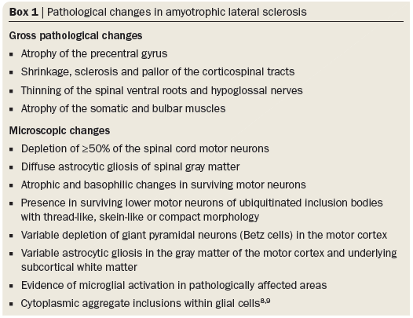
(Ferraiuolo et al. 2011)

Slide 12
Pathophysiology
Progressive degeneration and loss of motor neurons:
UMN in motor cortex and corticospinal tract
Brainstem nuclei for CN V (trigeminal), VII (facial), IX (glossopharyngeal), X (vagus) XII (hypoglossal)
Anterior horn cells in spinal cord (LMN)
Oculomotor, trochlear and abducens, as well as anterior horn cells for S2 controlling pelvic floor, sensory system and spinocerebellar tracts are generally well spared

Slide 13
Pathophysiology
Motor neurons affected earliest & most severely
Large cell size & long axon means high metabolic demands & reliance on axonal transport mechanisms
Needs optimal mitochondrial function
High intrinsic oxidative stress
Vulnerable to excitotoxicity & dysregulation of intracellular Ca²⁺ homeostasis
High physiological expression of certain proteins like SOD1
Motor neurons more resistant to ALS: fast fatigue-resistant motor neurons in the spinal cord, oculomotor neurons in the brainstem & neurons in Onuf’s nucleus (sacral motor neurons)
(Ferraiuolo et al. 2011, Robberecht & Philips 2013)

Slide 14
Pathophysiology
As motor neurons degenerate, they can no longer control the muscle fibers they innervate
Healthy surrounding axons attempt to sprout and re-innervate partially denervated muscles
Accounts for preserving strength and function early in disease
Reinnervation can compensate for the progressive degeneration until motor unit loss is about 50%
Surviving motor units undergo enlargement (making them more susceptible to degenerative mechanisms characteristic of ALS)
As disease progresses, reinnervation can’t compensate for rate of degeneration 🡪 impairments develop

Slide 15
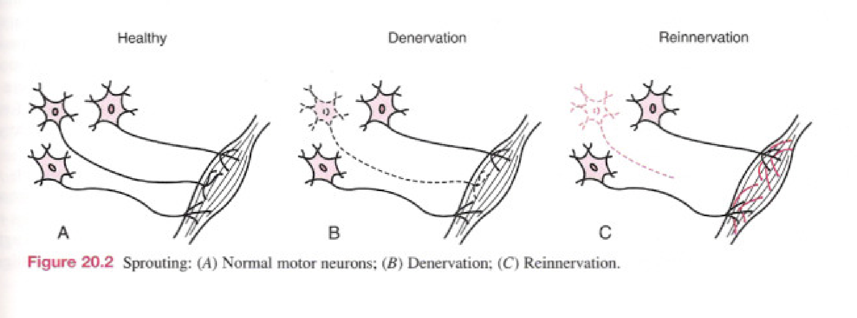
Pathophysiology
Motor Neuron Vulnerability
“As motor neurons die, the remaining motor neurons are overburdened ...as the disease progresses, reinnervation can’t compensate for denervation”.
(O’Sullivan & Schmidt, pg.821)
Notes:
Axon of affected motor neurons retract and denervation of the lower motor neurons or the muscle occurs. Initially, retraction is compensated by sprouting and collateral re‑innervation by axons from neurons that seem to be more resistant to the degenerative process. However, as the disease progresses, this compensational mechanism fails owing to the involvement of even the more resistant neurons.

Slide 16
Pathophysiology
Progression of motor neuron degeneration in ALS tends to spread within a region before progressing to other regions (in either a rostral or caudal manner)
Will see an increase in the number of affected motor neurons in area of onset before you see spread to other areas
Common areas of onset either cervical (affecting upper limbs), lumbar (affecting lower limbs) or bulbar (affecting speech and swallowing)
Onset is asymmetrical, tends to affect distal first
Caudal to rostral spread within spinal cord, and cervical to bulbar spread tend to occur fastest
(Kiernan et al. 2011)

Slide 17
Diagnosis
No specific diagnostic test for ALS
Dx reached after observing clinical signs associated with ALS & ruling out other pathologies with lab tests &/or imaging
Disease progression must be seen for dx of ALS (“mimic” syndromes do not progress as rapidly)
Objective sensory findings incompatible with dx of ALS (unless resulting from a co-morbidity)
Dx of ALS likely accurate in ~95% of cases
Time from symptom onset to dx is ~9-15 months
(Rowland & Shneider 2001, Mitchell & Bosario 2007, Hardiman et al. 2011)

Slide 18
Diagnosis
Dx requires the presence of:
LMN signs by clinical, electrophysiological or neuropathological exam
UMN signs by clinical exam
Progression of disease within a region or to other regions
Dx requires the absence of:
Evidence of other disease that may explain UMN and LMN signs
Neuroimaging evidence of other disease processes that may explain observed signs

Slide 19
Diagnosis
El Escortial Criteria – clinical dx
Developed by World Federation of Neurology Research Group on Motor Neuron Disease in 1994, revised 1998 & 2008 (Airlie House Revision)
Due to variability in clinical findings in early stages of ALS and the lack of absolute diagnostic markers
Broad clinical dx of clinically definite, probable, possible

Slide 20
Diagnosis
El Escortial Criteria – for your reference. I recommend reading document (but don’t need to memorize its contents)
http://www.alsa.org/assets/pdfs/fyi/criteria_for_diagnosis.pdf

Slide 21
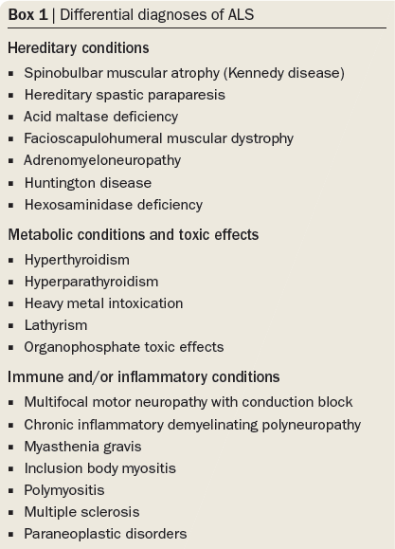
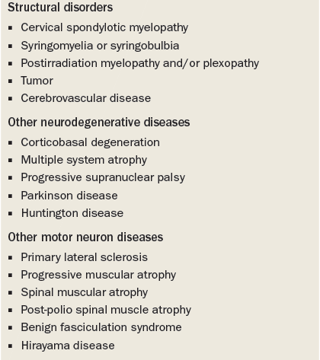
Differential Diagnosis
(Hardiman et al. 2011)
Notes:
Typically patients with a different dx don’t progress as rapidly & tend to survive longer
Correct diagnosis is important b/c some conditions are treatable (e.g., esophageal carcinoma & myasthenia gravis)

Slide 22
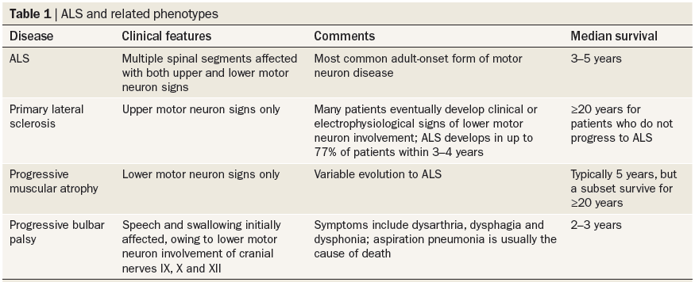
Differential Diagnosis
Other Motor Neuron Diseases
(Hardiman et al. 2011)
Notes:
There are variant syndromes: progressive spinal muscular atrophy is a lower mn syndrome with no upper mn signs, some of these individuals eventually develop full ALS, conversely primary lateral sclerosis is a pure upper mn, some eventually develop lower mn signs & therefore develop ALS before their death (Mitchell & Borasio) (Rowland & Shneider 2001)

Slide 23
Disease Course
Progressive and deteriorating disease
Progression from pathology to impairment to activity limitations to participation restrictions is inevitable
Average duration from diagnosis to death is 27-43 months
Death usually from respiratory failure
Very few survive after 5 years

Slide 24
Prognosis
Better prognosis:
Age at time of onset
Patients dx under the age of 40 had better 5 year survival rates than older adults
Limb onset better prognosis than bulbar onset
Less severe involvement at time of diagnosis
Longer interval between onset and diagnosis
No symptoms of dyspnea at onset

Slide 25
Prognosis
Individuals with psychological well-being had significantly longer survival times compared to those with psychological distress
Study of 144 individuals found that a mortality rate 6.8x greater in those experiencing psychological distress (McDonald et al. 1994, Johnston et al. 1999)

Slide 26
Prognosis
Terminal Phase
>60% die within 3 years of diagnosis, of remaining individuals 10% live for >8 years
Retrospective survey: >90% of patients died peacefully in their sleep (if no mechanical ventilation: sleep → coma due to hypercapnia)
20% of individuals with ALS in the Netherlands have died through euthanasia or physician-assisted suicide
Patients should be counseled on the terminal phase
In the event of terminal respiratory failure, how do they want their care to proceed?
Care decisions should be reviewed regularly because preferences for life-sustaining treatments can change with time
(Mitchell & Bosario 2007, Hardiman et al. 2011)
Notes:
tracheostomy can eventually result in locked-in syndrome & death on ICU unit, most pts usually refuse it

Slide 27
Clinical Manifestation
Vary depending on:
location and extent of motor neuron loss
Combination of LMN and UMN loss
Pattern of onset and progression
Body region(s) affected
Stage of disease
Onset focal and asymmetrical
As disease progresses, increase in severity, location and number of impairments

Slide 28
Clinical Manifestation
Gradual onset over months
First symptoms are UMN & LMN signs in 1 limb that spread to other areas
Initial weakness usually in isolated muscles, often distally
Sensory exam usually normal
Preservation of oculomotor, bowel & bladder functions
Disease phenotype categorized by site of onset:
Bulbar-onset – 20-30% of patients
Limb onset:
Cervical-onset
Lumbar-onset
Cervical- or lumbar-onset, occur in ~equal proportions
35.5% of patients had cervical-onset, 34.9% had lumbar-onset (Korner et al. 2011)
Respiratory-onset – rare less than 5% of patients
(Hardiman et al. 2011, van Groenestijn et al. 2011, Singh 2012)

Slide 29
Clinical Manifestation
Impairments related to LMN pathology:
asymmetrical muscle weakness
May begin in LE, UE or bulbar muscles
Muscle weakness is cardinal sign of ALS
Focal - Starts in isolated muscles
Tends to progress distal to proximal
Patient may start to notice a toe drag or foot slap; difficulty with buttons or writing; changes in voice or difficulty moving tongue

Slide 30
Clinical Manifestation
Impairments related to LMN pathology
Muscle weakness leads to secondary impairments:
Decreased ROM, predisposition to joint subluxation, tendon shortening, contractures,
Postural control issues
Decreased functional ability
Deconditioning
Fatigue
Pain (sensory pathways tend to be spared… pain is usually due to decreased movement)
Fasciculations and muscle cramping
Thought to be linked to hyperexcitability of motor axons
Muscle fibers (vs entire muscle)
Hyporeflexia
Decreased muscle tone

Slide 31
Clinical Manifestation
Impairments related to UMN pathology
Spasticity
Hyperreflexia
Clonus and other pathological reflexes
Dyssynergistic movement patterns
As disease progresses UMN may decrease (or become less evident)

Slide 32
Clinical Manifestation
Impairments related to bulbar pathology
In ALS see a ‘mixed’ bulbar palsy
Some spastic and some flaccid components
Dysarthria
Dysphagia
Pseudobulbar affect
Poor emotional control
Spontaneous crying or laughter in absence of emotional triggers or out of context

Slide 33
Clinical Manifestation
Respiratory Involvement:
Dyspnea
Attacks can cause anxiety
Respiratory muscle weakness
Chronic nocturnal hypoventilation
Leads to disordered sleep & daytime fatigue
Can occur months or years before respiratory failure
Significantly ↓ quality of life
Thick mucous secretions from ↓ fluid intake & ↓ coughing pressure
Pneumonia common
(Lechtzin, et al. 2002, Mitchell & Borasio 2007, Hardiman et al. 2011)

Slide 34
Clinical Manifestation
Cognitive
Newer area of research
Estimated 20% of cases
‘frontal lobe dementia’
Loss of insight, emotional blunting, typically presents as changes in language (vs loss of memory)
Cognitive impairments
Attention deficits
Behavioural
Irritability
Social disinhibition

Slide 35
Medical Management of ALS
Disease-modifying Treatment:
Riluzole
only FDA-approved, disease-modifying drug for ALS
Inhibits presynaptic release of glutamate (↓ toxic effect of excessive glutamate)
↑ lifespan by 3-6 months
Neurotrophins
E.g., recombinant insulin-like nerve growth factor 1
Being investigated as a way to save dying motor neurons
Olexisome 64
Neuroprotective compound that targets mitochondria
Since there are few disease-modifying treatment options, focus on symptom control, maintaining quality of life & palliative care

Slide 36
Medical Management of ALS
Symptom Control:
Chronic dyspnea
Short acting benzodiazepines or morphine
Major depression
Selective serotonin reuptake inhibitors often used
Amitriptyline – has positive effects on other symptoms (e.g., drooling, emotional lability, sleep disturbance)
Attend to caregiver’s mental health
Pathological laughing &/or crying
Responds well to drugs (e.g., dextromethorphan with quinidine)
Notes:
Caregiver’s mental health can affect pt’s mental health

Slide 37
Medical Management of ALS
Symptom Control (cont’d):
Pain
Non-steroidal anti-inflammatories, opioids
Thick secretions
mucolytic drugs (e.g., acetylcysteine or saline nebulizer with beta-receptor antagonists)
Spasticity
Baclofen, tizanidine, etc.

Slide 38
Questions for Review
Describe the disease course of ALS.
What factors have shown a relationship to prognosis?

Slide 39
Based on your previous knowledge of neurorehabiliation, this presented information on ALS, and your clinical experience, address the concepts on the following slides.
You may need to consult additional resources such as:
Blumenfeld H. Neuroanatomy through Clinical Cases. 2nd ed. Sunderland: Sinauer; 2010
Umphred D, editor. Neurological Rehabilitation. 6th ed. St. Louis: Mosby; 2012
O’Sullivan S, Schmitz T, Fulk, G. Physical Rehabilitation. 6th ed. Philadelphia: F. A. Davis; 2014
Rehabmeasures.org

Slide 40
Take some time PRIOR TO IN-PERSON CLASS on Wed May 18 and brainstorm the information pertaining to the following slides on PT assessment, impairments, and treatment

Slide 41
PT Assessment for ALS

Slide 42
Common Impairments in ALS

Slide 43
Common Activity Limitations in ALS

Slide 44
Common Participation Restrictions in ALS

Slide 45
PT Treatment and Management for ALS

Slide 46
Challenges for PT

